Slide 1
Supporting young people in music
since 2003
Children in Scotland 2021 Music Matters

Slide 2
About The Sound Lab
The Sound Lab bring free, fun and engaging music tuition and networking opportunities to young people who face barriers accessing the music industries
We provide meaningful and supportive employment opportunities for music and creative practitioners.
Entirely volunteer and youth run since 2003
With a small team of young volunteers, in 2020 we…
Provided over 600 hours of free tuition workshops for young people across Scotland
Supported over 150 young musicians to develop their skills and achieve their musical goals
Produced 20+ YouTube tutorial videos
Produced 10 young people-led radio shows and podcasts showcasing their music
Held 4 online festivals with young people who face acute barriers to accessing music
Helped 3 other charities to deliver food and essentials during the pandemic

Slide 3
+
=
1st national music project for care experienced young people in Scotland
2 year project running up to June 2021, working with over 400 care experienced young people across Scotland
Aims of the project:
To provide as many care experienced young people as possible with enjoyable music mentoring, tuition and advice
To learn about what works and doesn’t work in bringing music and creativity to care experienced young people
Funded by Creative Scotland and Big Lottery Young Start, following a successful pilot funded by the Life Changes Trust

Slide 4
Musicares participants can choose from any of musical instrument or creative activity. The structure, duration and format of the programme can be defined by the young person.
Focus on residential and secure care but also open to foster care, kinship care and young people who are looked after at home
Any age between 5 – 25
Tuition is delivered 1-2-1 or in small groups, larger sessions or events
Sound Lab caters mostly to Glasgow and surrounding areas (Renfrewshire, East Ren, Inverclyde, West Dunbartonshire etc.)
Music Plus caters mostly to Edinburgh, Aberdeen, Highlands, Dumfries & Galloway, Ayrshires and any other areas of Scotland

Slide 5
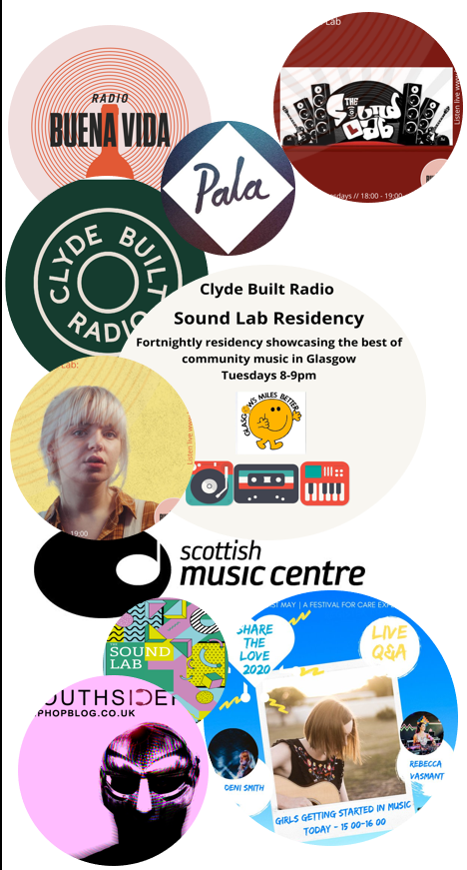
Music Broth run ‘Scotland’s loudest library’ and have been a key partner in our work, allowing us access to their library of instruments and delivering this to participants as far as Orkney.
Though, like many services, we’ve had to adapt and change over the course of the pandemic, there are opportunities within that; distanced tuition has in some ways made our work more accessible.
Musicares represents a large part of The Sound Lab’s work over the last 2 years, however we have been busy delivering other workshops and tuition to groups out-with the care experienced community. Some of which you’ll hear about today.

